Slide 1
Sprint Review
Iteration Meeting
dd/month/yyyy
<Your name>

Slide 2

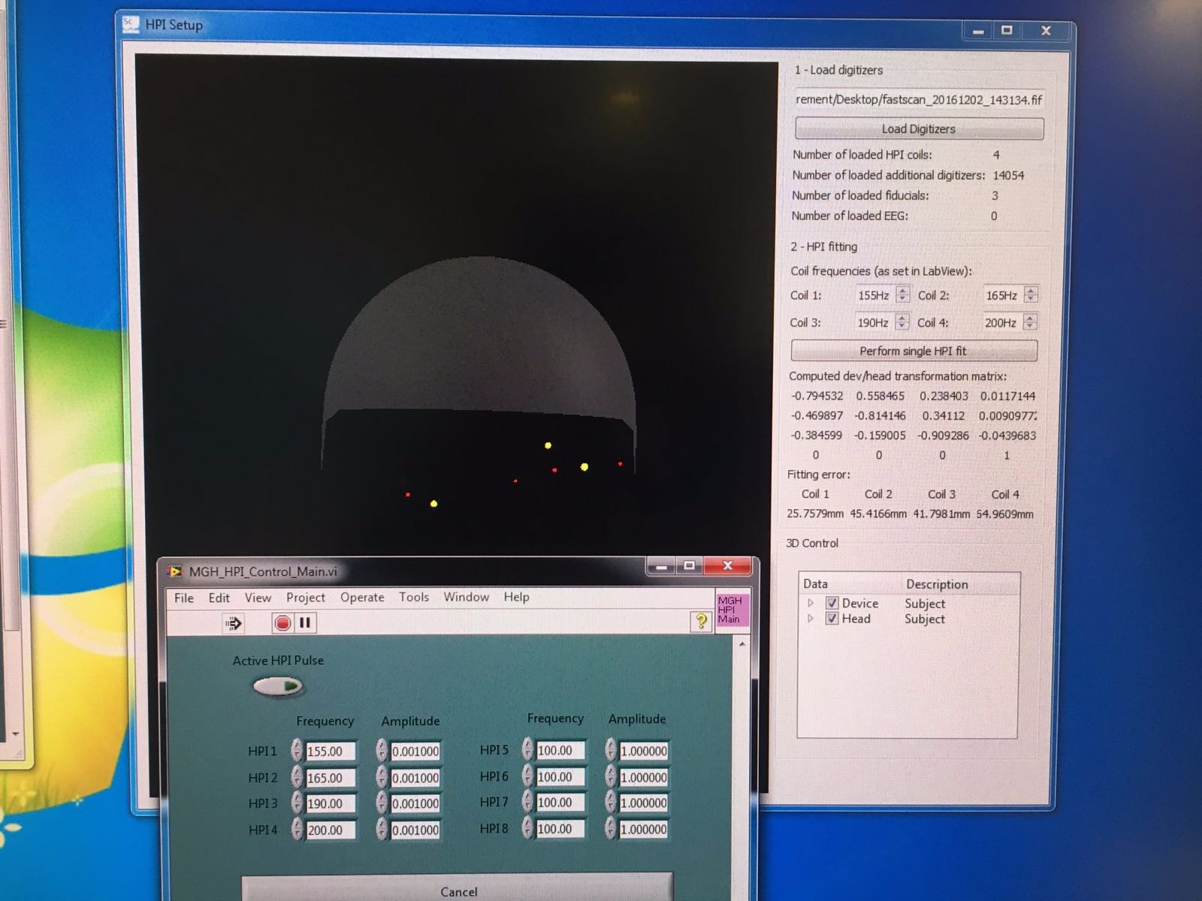
Sprint Review: MNE Scan
SC-127: Debug HPI fitting for real subjects – Done
First session with real subject - „okish“ results
Movement artifacts are most likley corrupting the fit (need to consult Matti)

Slide 3

Sprint Review: MNE Lib
LIB-123: Implement connectivity measure – Done
Pearson‘s Correlation coefficient
!LIB-124: Integrate simple, multiple light into Disp3D – Done
Point and directional light support added with color changing and sphere cisualization
!LIB-63: Generalize examples by extending CLI input – Done
Cleaned and improved all examples
!LIB-113: Rename SurfaceSetTreeItem to MeasurementTreeItem – Done
Some refactoring in Disp3D, next to MVC controller implemetnation in Disp3D

Slide 4
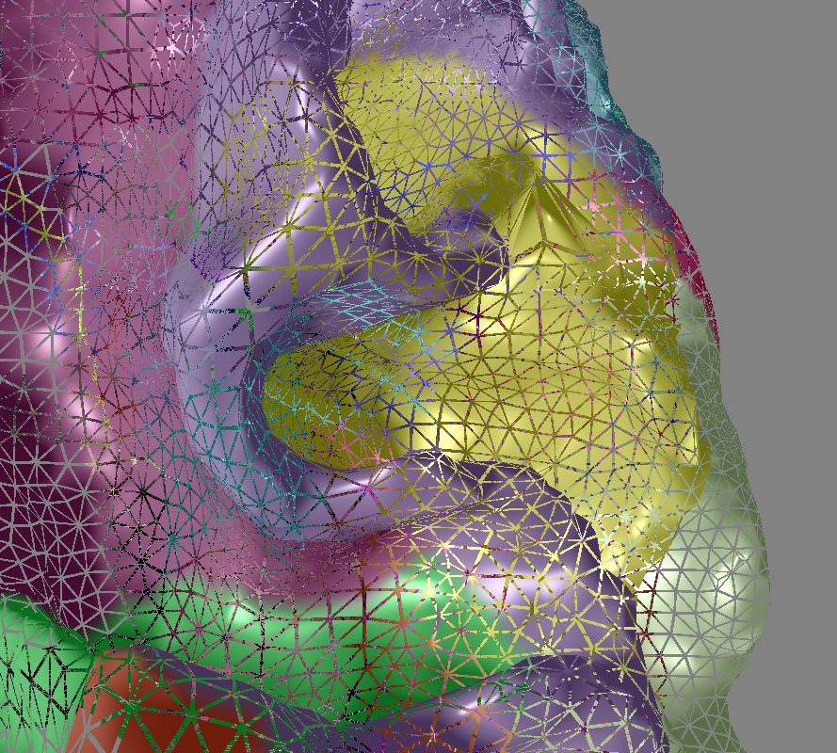
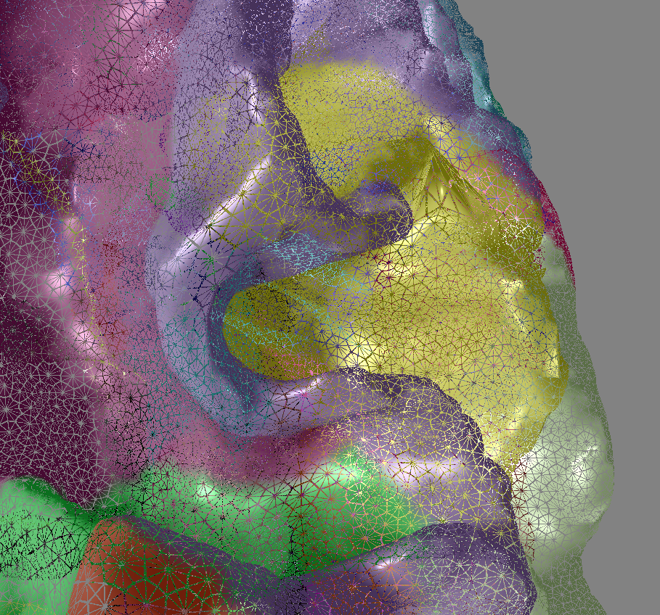
Sprint Review: MNE Lib
!LIB-125: Add tesselation shader to Disp3D – Done
Wanted to increase brain surface topology smoothness
We now have full support for all shader stages (vert,tcs,tes,geom,frag)
Simple
interpolation
method

Slide 5
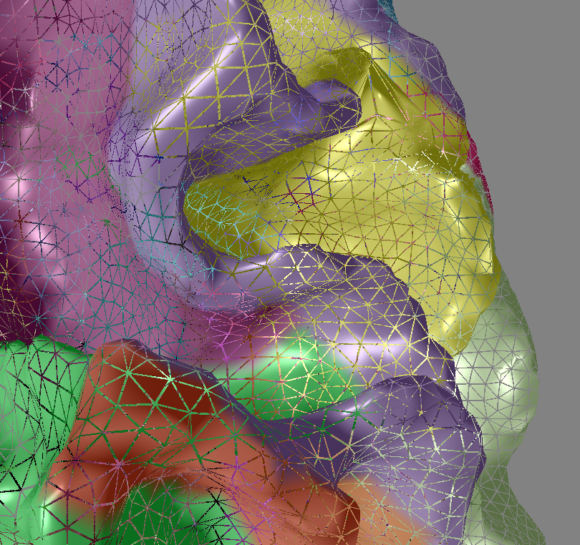
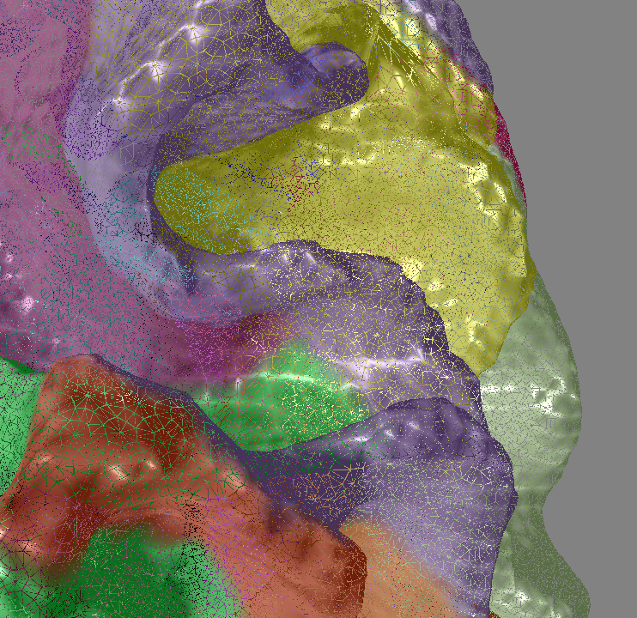
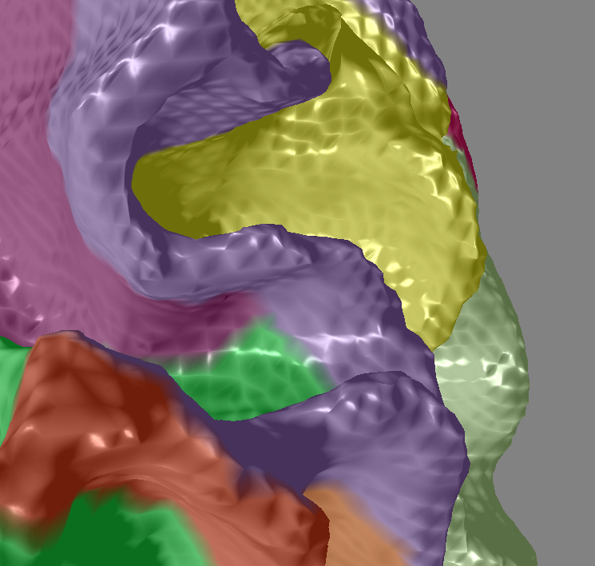
Sprint Review: MNE Lib
Advanced (Bezier PN triangle) interpolation method
Tess Off
Triangle scaling On
Tess On
Triangle scaling On
Tess On
Triangle scaling Off

Slide 6

Sprint Review: Summary
Main highlight: <What was your personal highlight?>
Main problem: <What was your main problem or bothering you? What was a major tak blocker?>
Self evaluation: <What are you particular proud of? Where/What could you improve?>

Slide 7
Sprint Planning
Iteration Meeting
dd/month/yyyy
<Your name>

Slide 8
Sprint Planning
My upcoming/planned tasks:
MNE Lib:
Improve HPI fitting routine (5d)
Implement improved network visualization using shaders (5d)
MNE Scan:
EEGoSports Buffer problem (2.5d)

